Slide 1
CELL CYCLE AND MITOSIS

Slide 2
Growth— an increase in size or mass of a developing living system— is an irreversible process that occurs at all organizational levels. Often, it is difficult to define, because, it is. multifactorial, that is, growth embodies following three interacting growth patterns :
(1) auxetic growth— an increase in cell mass or auxesis ;
(2) multiplicative growth— an increase in cell number due to cell division; and
(3) accretionary growth— growth due to accumulation of extracellular products (accretion means increase by addition on the surface of the material of same nature as that is already present, e.g., the manner of growth of crystal). Generally, when rate of anabolism (i.e., photosynthesis, protein synthesis, etc.) far exceeds the rate of catabolism (i.e., respiration), the growth of protoplasm (i.e., auxetic growth) takes place.

Slide 3
CELL CYCLE AND MITOSIS
All cells are produced by divisions of pre-existing cell. Continuity of life depends on cell division. A cell born after a division, proceeds to grow by macromolecular synthesis, reaches a species-determined division size and divides. This cycle acts as a unit of biological time and defines life history of a cell. Cell cycle can be defined as the entire sequence of events happening from the end of one nuclear division to the beginning of the next. The cell cycle involves the following three cycles (see Albert et al., 1989).
1. Chromosome cycle. In it DNA synthesis alternates with mitosis (or karyokinesis or nuclear division). During DNA synthesis, each double-helical DNA molecule is replicated into two identical daughter DNA molecules and during mitosis the duplicated copies of the genome are ultimately separated.
2. Cytoplasmic cycle. In it cell growth alternates with cytokinesis (or cytoplasmic division). During cell growth many other components of the cell (RNA, proteins and membranes) become double in quantity and during cytokinesis cell as a whole divides into two. Usually the karyokinesis is followed by the cytokinesis but sometimes the cytokinesis does not follow the karyokinesis and results into the multinucleate cell, e.g., cleavage of egg in Drosophila.
3. Centrosome cycle. Both of the above cycles require that the centrosome be inherited reliably and duplicated precisely in order to form the two poles of the mitotic spindle ; thus, centrosome cycle forms the third component of cell cycle.

Slide 4
Howard and Pelc (1953) have divided cell cycle into four phases or stages : G1, S, G2 and M phase. The G1 phase, S phase and G2 phase are combined to from the classical interphase.
1. G1 Phase. After the M phase of previous cell cycle, the daughter cells begin G1 of interphase of new cell cycle. G1 is a resting phase. It is called first gap phase, since no DNA synthesis takes place during this stage; currently, G1 is also called first growth phase, since it involves synthesis of RNA, proteins and membranes which leads to the growth of nucleus and cytoplasm of each daughter cell towards their mature size (see Maclean and Hall, 1987).
During G1 phase, chromatin is fully extended and not distinguishable as discrete chromosomes with the light microscope. This is a time of resumption of normal cell metabolism which has slowed down during the previous cell division.
Thus, G1 involves transcription of three types of RNAs, namely rRNA, tRNA and mRNA ; rRNA synthesis is indicated by the appearance of nucleolus in the interphase (G1 phase) nucleus.
Proteins synthesized during G1 phase (1) regulatory proteins which control various events of mitosis ; (2) enzymes (e.g., DNA polymerase) necessary for DNA synthesis of the next stage ; and (3) tubulin and other mitotic apparatus proteins. G1 phase is most variable as to duration (Table 18-1) ; it either occupies 30 to 50 per cent of the total time of the cell cycle or lacks entirely in rapidly dividing cells (e.g., blastomeres of early embryo of frog and mammals).
Terminally differentiated somatic cells (i.e., end cells such as neurons and striated muscle cells) that no longer divide, are arrested usually in the G1 stage; such a type of G1 phase is called G0 phase.

Slide 5
2. S phase. During the S phase or synthetic phase of interphase, replication of DNA and synthesis of histone proteins occur.
New histones are required in massive amounts immediately at the beginning of the S period of DNA synthesis to provide the new DNA with nucleosomes. Thus, at the end of S phase, each chromosome has two DNA molecules and a duplicate set of genes.
S phase occupies roughly 35 to 45 per cent of cell cycle.
3. G2 phase. This is a second gap or growth phase or resting phase of interphase. During G2 phase, synthesis of RNA and proteins continues which is required for cell growth. It may occupy 10 to 20 per cent time of cell cycle.
As the G2 phase draws to a close, the cell enters the M phase.

Slide 6
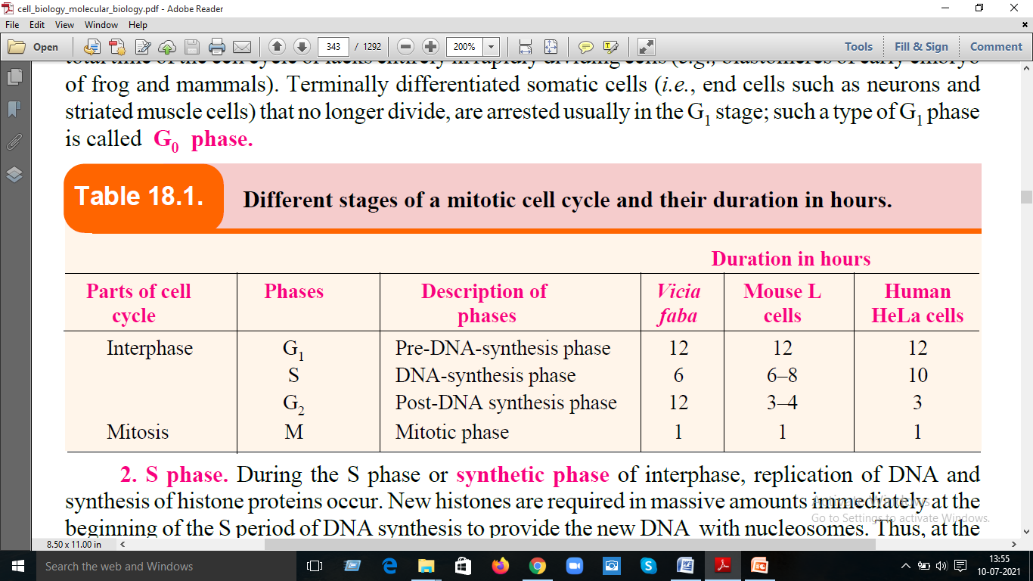

Slide 7
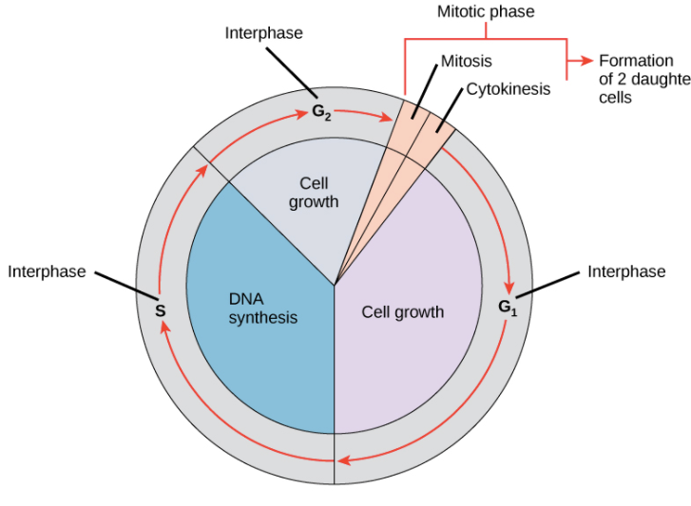

Slide 8
General Events of Interphase:
The interphase is characterized by the following features :
The nuclear envelope remains intact. The chromosomes occur in the form of diffused, long, coiled and indistinctly visible chromatin fibres
The DNA amount becomes double. Due to accumulation of ribosomal RNA (rRNA) and ribosomal proteins in the nucleolus, the size of the latter is greatly increased.
In animal cells, a daughter pair of centrioles originates near the already existing centriole and, thus, an interphase cell has two pairs of centrioles.
In animal cells, net membrane biosynthesis increases just before cell division (mitosis). This extra membrane seems to be stored as blebs on the surface of the cells about to divide.

Slide 9
4. M phase or Mitotic phase.
The mitosis (Gr., mitos=thread) occurs in the somatic cells and it is meant for the multiplication of cell number during embryogenesis and blastogenesis of plants and animals.
Fundamentally, it remains related with the growth of an individual from zygote to adult stage. Mitosis starts at the culmination point of interphase (i.e., G2 phase). I
t is a short period of chromosome condensation, segregation and cytoplasmic division. Mitosis is important for replacement of cells lost to natureal friction (attrition), wear and tear and for wound healing.

Slide 10
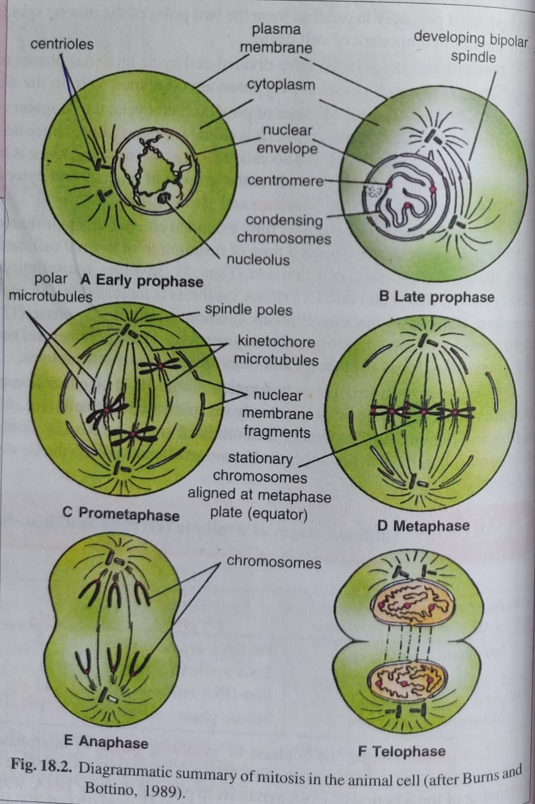

Slide 11
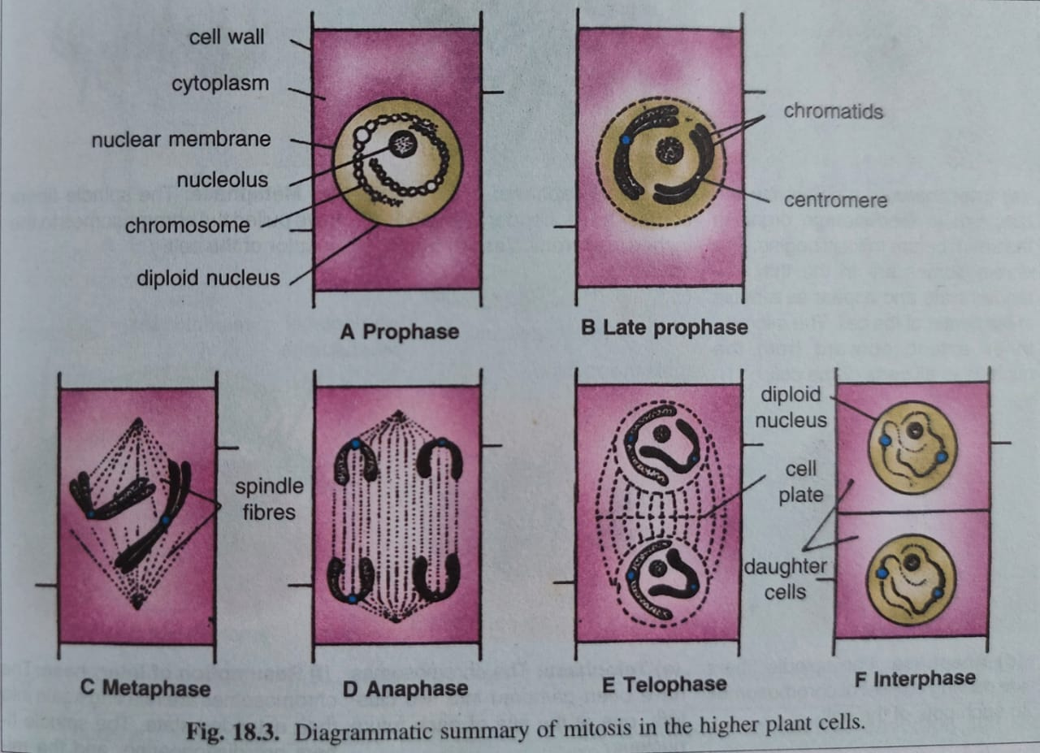

Slide 12
As a process, mitosis is remarkably similar in all animals and plants. It is a smoothly continuous
process and is divided arbitrarily into following stages or phases :
1. Prophase. The appearance of thin-thread like condensing chromosomes marks the first phase
of mitosis, called prophase (Gr., pro=before ; phasis=appearance). The cell becomes spheroid, more refractile and viscous. Each prophase chromosome is composed of two coiled filaments, the chromatids, which are the result of the replication of DNA during the S phase.
As prophase progresses, the chromatids become shorter and thicker and two sister chromatids of each chromosome are held together by a special DNA-containing region, called the centromere or primary constriction. During prophase, proteins of the trilaminar kinetochores (one for each chromatid) start depositing or organizing on the centromere of each chromosome (see Darnell et al., 1986).
Further, during early prophase, the chromosomes are evenly distributed in the nuclear cavity ; as prophase progresses, the chromosomes approach the nuclear envelope, causing the central space of the nucleus to become empty. In the cytoplasm, the most conspicuous change is the formation of the spindle or mitotic apparatus.

Slide 13
In the early prophase, there are two pairs of centrioles, each one surrounded by the socalled aster which is composed of microtubules radiating in all directions. The two pairs of centrioles migrate to opposite poles of the cell along with the asters and become situated in antipodal positions. Between the separating centrioles forms a spindle. The microtubules of the spindle are arranged like two cones base to base, broad at the centre or equator of the cell and narrowing to a point at either end or pole.
Mitotic spindle contains three main types of fibres :
(1) polar fibres, which extend from the two poles of the spindle toward the equator ;
(2) kinetochore fibres, which attach to the kinetochores of centromeres of each mitotic chromosomes and extend toward the poles ; and
(3) astral fibres, which radiate outward from the poles toward the periphery or cortex of cell.
In cells of most higher plants, however, spindle forms without the aid of centrioles and lacks asters Lastly, during prophase, the nucleolus gradually disintegrates.
Degeneration and disappearance of the nuclear envelope marks the end of prophase. This process is incompletely understood. However, following two factors may be involved in this process : 1. Enzymatic action either by some mitochondrial enzymes, cytosolic MPF kinase or nuclear RNA (or ribozyme ; Burns and Bottino, 1989). 2. Physical action, i.e., physical stress exerted by microtubules which become attached to the nuclear envelope.

Slide 14
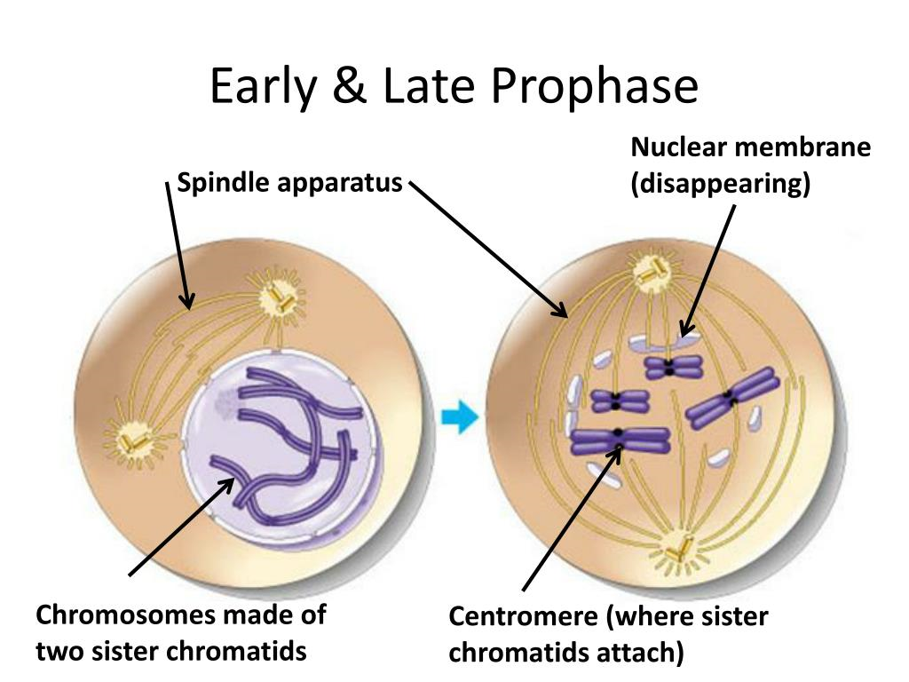

Slide 15
There are variations available with respect to the dissolution of nuclear envelope and the nucleolus. In a number of primitive classes of plants and animals the nuclear envelope does not dissolve during mitosis.
Prometaphase. The breakdown of nuclear envelope signals the commencement of and enables the mitotic spindle to interact with the chromosomes.
This stage is characterized by a period of frantic activity during which the spindle appears to be trying to contain and align the chromosomes at the metaphase plate.
In fact, at this stage the chromosomes are violently rotated and oscillated back and forth between the spindle poles because their kinetochores are capturing the plus ends of microtubules growing from one or the other spindle pole and are being pulled by the captured microtubules.
The kinetochores thereby act as a “cap” that tends to protect the plus end from depolymerizing, just as the centrosome at the spindle pole tends to protect the minus end from depolymerizing. Thus, sister chromatids become attached by their kinetochores to opposite poles ; balanced bipolar forces hold chromosomes on the metaphase plate

Slide 16
2. Metaphase. During metaphase (Gr.,meta=after; phasis =appearance) the chromosomes are shortest and thickest.
Their centromeres occupy the plane of the equator of the mitotic apparatus (a region known as the equatorial or metaphase plate), although the chromosomal arms may extend in any direction.
At this stage the sister chromatids are still held together by centromere and the kinetochores of the two sister chromatids face opposite poles ; this would permit proper separation in the next phase (anaphase).
Metaphase occupies a substantial portion of the mitotic phase, as if the cell pause until all their chromosomes are lined up appropriately on the metaphase plate.
At metaphase, subunits (tubulin dimers) are added to the plus end of a microtubule at the kinetochore and are removed from the minus end at the spindle pole. Thus, a poleward flux of tubulin subunits occurs, with the microtubules remaining stationary and under tension.

Slide 17
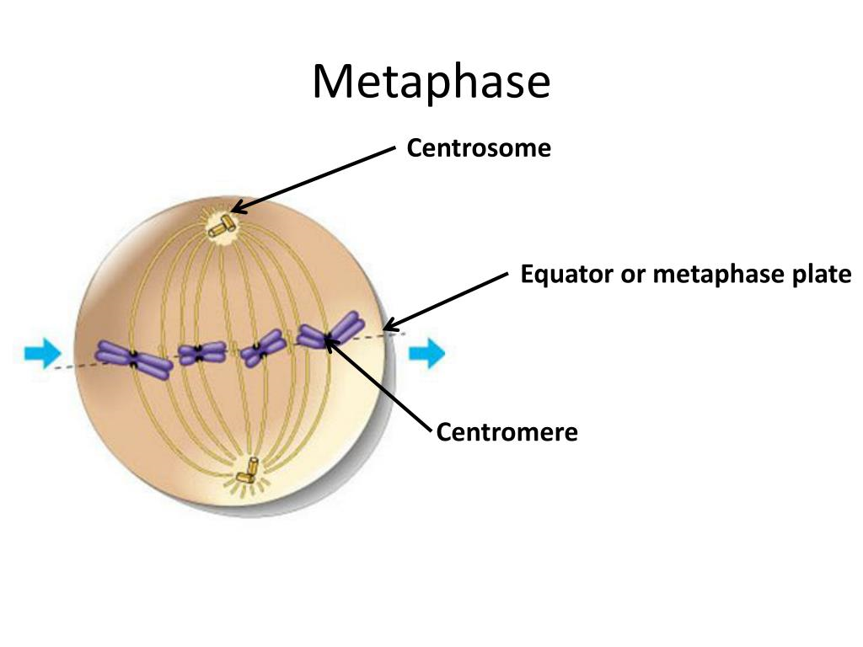

Slide 18
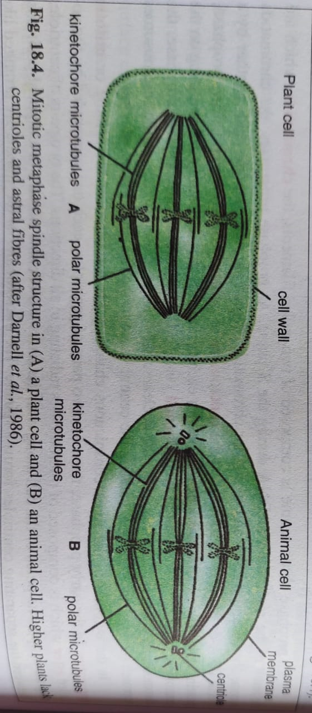

Slide 19
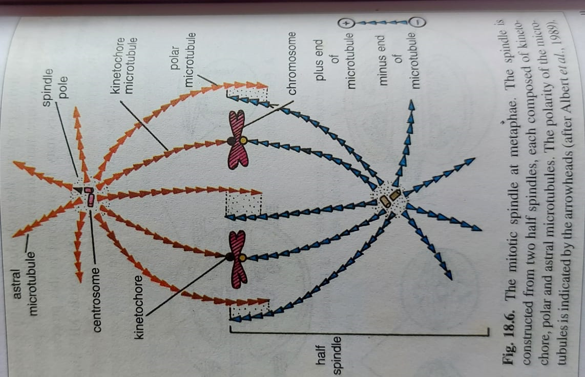

Slide 20
3. Anaphase. The anaphase (Gr., ana=up ; phasis=appearance) begins abruptly with the synchronous splitting of each chromosome into its sister chromatids, called daughter chromosomes, each with one kinetochore. Synchronous splitting of each centromere during prophase is evidently caused by an increase in cytosolic Ca2+. In fact, Ca2+-containing membrane vesicles accumulate at spindle poles and release calcium ions to initiate anaphase (Hapler and coworkers, 1980, 1987).
Anaphase involves the following two steps :
(i) Anaphase A. During it, there is poleward movement of chromatids due to shortening of the kinetochore microtubules. During their poleward migration, the centromeres (and kinetochores) remain foremost so that the chromosomes characteristically appear U,V or J- shaped.
(ii) Anaphase B. It involves separation of poles themselves accompanied by the elongation of the polar microtubules. The astral microtubules also help in anaphase B by their attractive interaction with cell cortex.

Slide 21
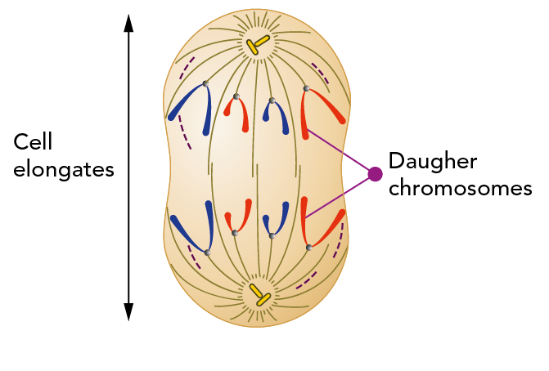

Slide 22
4. Telophase. The end of the polar migration of the daughter chromosomes marks the beginning of the telophase ; which in turn is terminated by the reorganization of two new nuclei and their entry into the G1 phase of interphase.
In general terms, the events of prophase occur in reverse sequence during this phase. A nuclear envelope reassembles around each group of chromosomes to form two daughter nuclei.
The mitotic apparatus except the centrioles disappears ; high viscosity of the cytoplasm decreases; the chromosomes resume their long, slender, extended form as their coils relax; and RNA- synthesis restarts causing the nucleolus to reappear.

Slide 23
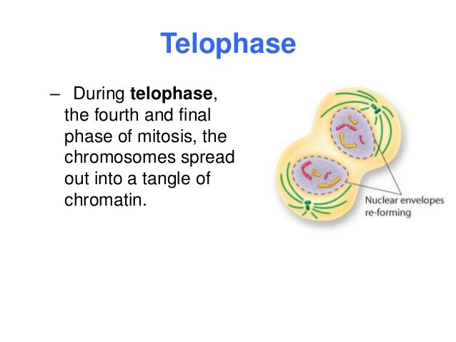

Slide 24
Cytokinesis
Both DNA synthesis and mitosis are coupled to cytoplasmic divison, or cytokinesis—the constriction of cytoplasm into two separate cells.
During cytokinesis, the cytoplasm divides by a process, called cleavage. The mitotic spindle plays an important role in determining where and when cleavage occurs.
Cytokinesis usually begins in anaphase and continues through telophase and into interphase. The first sign of cleavage in animal cells is puckering and furrowing of the plasma membrane during anaphase.
The furrowing invariably occurs in the plane of the metaphase plate, at right angles to the long axis of the mitotic spindle. A cleavage furrow tends to form midway between asters originating from two centrosomes in fertilized sand dollar eggs.

Slide 25
Cleavage is accomplished by the contraction of a ring composed mainly of actin filaments. This bundle of filaments, called contractile ring, is bound to the cytoplasmic face of the plasma membrane by unidentified attachment proteins. The contractile ring assembles in early anaphase, once assembled, it develops a force large enough to bend a fine glass needle inserted into the cell. Evidently this force is generated due to muscle-like sliding of actin and myosin filaments in the contractile ring. The actin-myosin interaction pulls the plasma membrane down into a furrow. During a normal cytokinesis, the contractile ring does not get thicker as the furrow invaginates, suggesting that it continuouly reduces its volume by losing filaments. When cleavage ends, the contractile ring is finally dispensed with altogether and the plasma membrane of the cleavage furrow narrows to form the midbody, which remains as a tether (Tether means a rope for confining a beast within certain limits) between two daughter cells. The midbody contains the remains of the two sets of polar microtubules, packed tightly together with dense matrix material. Cytokinesis greatly increases the total cell-surface area as two cells form from one. Therefore, the two daughter cells resulting from cytokinesis require more plasma membrane than in the plant cell. Lastly, prior to cytokinesis, in M phase large membrane-bounded organelles such as Golgi apparatus and the endoplasmic reticulum break up into smaller fragments and vesicles ; this may ensure their even distribution into daughter cells during cytokinesis.

Slide 26
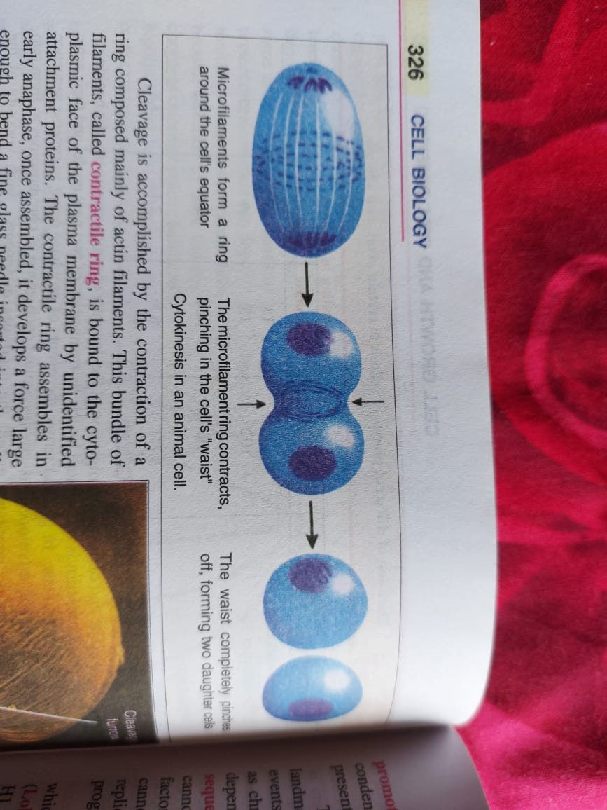

Slide 27
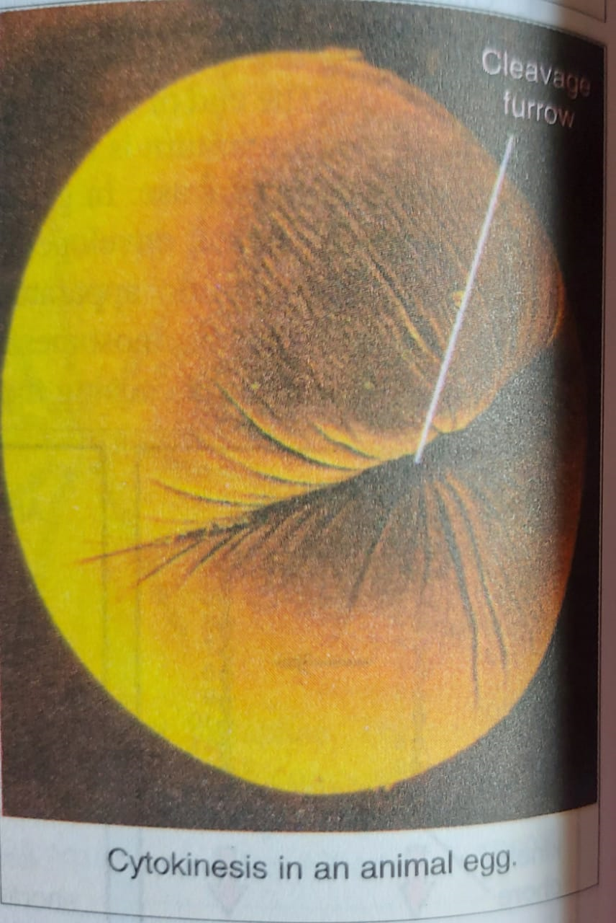

Slide 28
Significance of Mitosis
The mitosis has the following singificance for living organisms :
1. The mitosis helps the cell in maintaining proper size.
2. It helps in the maintenance of an equilibrium in the amount of DNA and RNA in the cell.
3. The mitosis provides the opportunity for the growth and development to organs and the body of the organisms.
4. The old decaying and dead cells of body are replaced by the help of mitosis.
5. In certain organisms, the mitosis is involved in asexual reproduction.
6. The gonads and the sex cells depend on the mitosis for the increase in their number.
7. The cleavage of egg during embryogenesis and division of blastema during blastogenesis, both involve mitosis.

